Slide 1
AI-Augmented Backend Development
AI FAQ Assistant API • College Project Presentation
AI FAQ Assistant
A student-friendly FAQ REST API that stores common questions in SQLite and can
use an optional AI fallback for unknown questions.
Python
FastAPI
SQLite
HTML/CSS/
JavaScript
1

Slide 2
Project Overview
A compact backend + web interface for academic FAQ management.
USER INTERFACE
FASTAPI BACKEND
DATABASE + AI
Students can enter
a question, view an
answer, add new
FAQs and manage
the FAQ list.
The API receives
requests, searches
the FAQ database
and returns responses
to the web page.
SQLite stores FAQs.
For an unknown
question, an optional
AI service can be
called as a fallback.
2

Slide 3
Problem Statement
Why the project is needed
• Students repeatedly search for answers to common academic questions.
• Information may be scattered across different sources.
• Repeated searching takes time and makes answers harder to manage.
• The project provides one simple question-and-answer interface.
• The same interface also supports adding and deleting FAQs.
3

Slide 4
Aim & Objectives
What the project is designed to achieve
AIM
OBJECTIVES
• Store FAQs using SQLite.
• Provide fast answers through an API.
• Add an optional AI fallback for unknown
questions.
• Demonstrate REST API operations.
• Provide a simple web interface for
students.
Develop a simple AI
augmented FAQ REST
API for answering and
managing frequently
asked academic
questions.
4

Slide 5
Technologies Used
Technology stack used in the project
Python
FastAPI
SQLite
Backend programming
language
REST API framework
Lightweight FAQ
database
HTML / CSS /
JavaScript
Optional AI API
Swagger / OpenAPI
Fallback for unknown
questions
API documentation
and testing
Web interface
5

Slide 6
System Architecture
How the user interface, API, database and optional AI work together
Student / Browser
HTML/CSS/JavaScript UI
FastAPI REST API
SQLite FAQ Database
Optional AI Service
The backend checks stored FAQs first. If no suitable match is found, the optional AI fallback can provide an answer.
6

Slide 7
Main Modules
Functional parts of the application
User Interface Module
FAQ Management Module
Collects questions and displays answers and
FAQ records.
Adds, lists and deletes FAQ records.
Question Answering Module
AI Integration Module
Searches the stored FAQ data for a suitable
answer.
Provides an optional fallback for unknown
questions.
Database Module
API Documentation Module
Uses SQLite to store FAQ information.
Uses Swagger / OpenAPI to document REST
endpoints.
7

Slide 8
API Endpoints
REST operations exposed by the FastAPI backend
GET
/api/faqs
View all FAQs
POST
/api/faqs
Add an FAQ
DELETE
/api/faqs/{id}
Delete an FAQ
POST
/api/ask
Ask a question
8

Slide 9
Working Algorithm
Step-by-step request and response flow
1
Student enters a question.
2
FastAPI receives the request.
3
Backend searches the SQLite FAQ database.
4
If a match is found, the stored answer is returned.
5
Otherwise, the optional AI service is called.
6
The answer is returned and displayed on the web page.
9

Slide 10
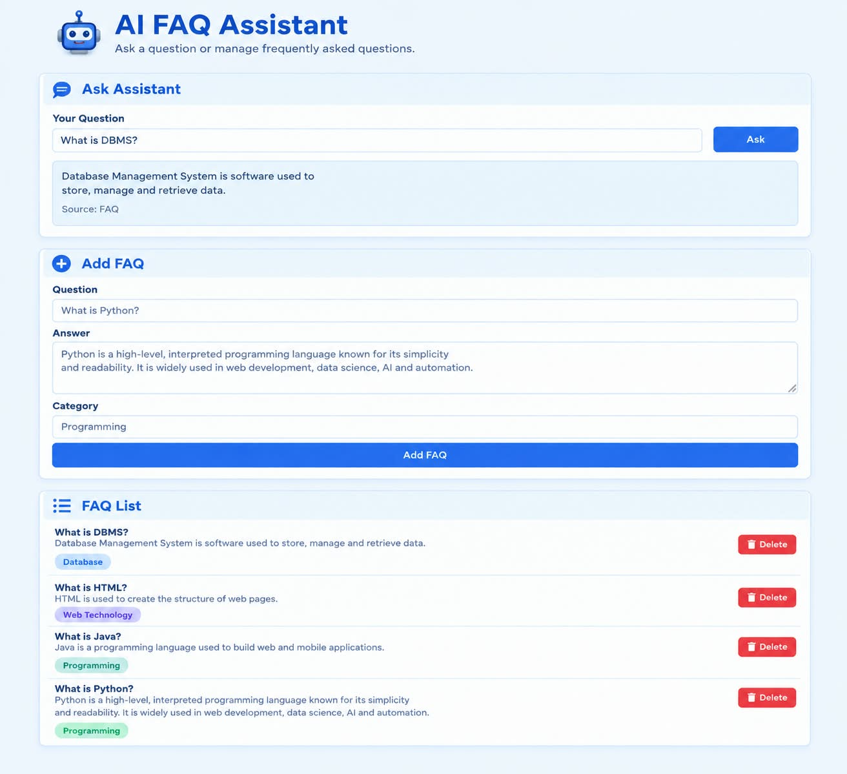
Expected Output
Complete working
interface:
Ask Assistant
• Add FAQ
• FAQ List
10

Slide 11
Testing
Basic functional test cases
Test
Action
Expected Result
Home page
Open application
Home page displayed
GET FAQs
Request FAQ list
FAQ list returned
Ask known question
Submit stored question
Correct stored answer
Add FAQ
Submit question, answer and category
New record created
Delete FAQ
Delete selected record
Record removed
Empty question
Submit blank question
Validation error
11

Slide 12
Advantages & Limitations
Project strengths and current constraints
ADVANTAGES
LIMITATIONS
• Simple, fast and low-cost.
• Easy to extend.
• Fast access to stored FAQ
answers.
• SQLite needs no separate
database server.
• Basic matching uses keywords.
• AI fallback needs a configured
API key.
• Current version focuses on
FAQ-style question answering
rather than full conversational
history.
12

Slide 13
Future Enhancements
Possible improvements toward a full AI StudyBuddy system
JWT authentication
PDF / document upload
Secure user access and API operations.
Allow learning content to be added.
RAG-based answers
Chat history
Use retrieved documents to support answers.
Keep previous student questions and answers.
Quiz generation
Study-progress dashboard
Create practice questions from study content.
Track learning activity and progress.
Cloud deployment
Make the application available online.
13

Slide 14
Conclusion
Project outcome and scope
WHAT WE BUILT
WHAT IT
DEMONSTRATES
WHERE IT CAN GO
A simple student
FAQ solution
combining a web
interface, REST APIs
and SQLite storage.
The architecture can be
extended into a full
AI StudyBuddy system
with documents, RAG,
quizzes and progress
tracking.
FAQ CRUD operations
question answering
through an API,
database interaction
and optional AI fallback.
14

Slide 15
THANK YOU

